Slide 1
CSCI E-96 Harvard Fall 2018
Data Mining for Business
Ted Kwartler
https://www.linkedin.com/in/edwardkwartler/
ehk116@gmail.com

Slide 2
Agenda
Start | End | Item
 |  | Introductions
 |  | Syllabus Review
 |  | Break
 |  | Core Concepts in Data Mining
 |  | Q/A, Individualized help w/R environment & git

Slide 3
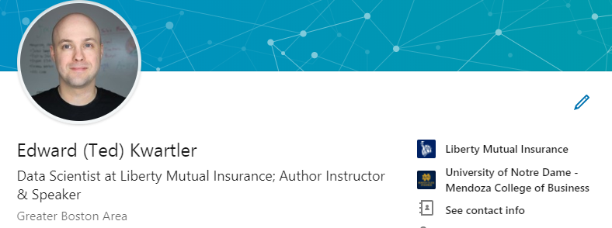
Introductions
Notes:
DS is a community therefore invest in your cohort here, contribute to the open source ethos

Slide 4
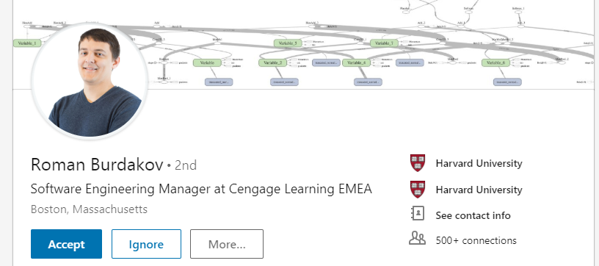
Introductions

Slide 5
On Piazza…
Where are you from?
Profession
Why did you take this course?
What do you hope to learn by the end of the course?
Tell us something interesting about yourself. Hobby? Family? Etc.
This helps myself and Roman get to know you along with what may be of interest for your learning style.

Slide 6
Agenda
Start | End | Item
 |  | Introductions
 |  | Syllabus Review
 |  | Break
 |  | Core Concepts in Data Mining
 |  | Q/A, Individualized help w/R environment & git

Slide 7
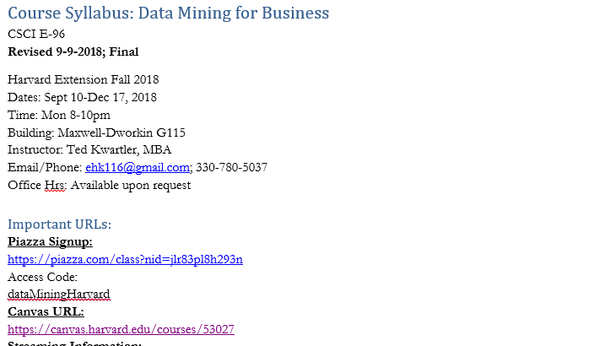
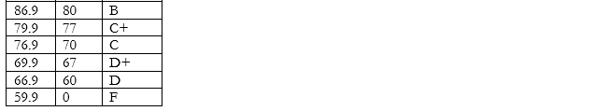
Syllabus Review

Slide 8
Community Learning Expectations
I expect:
Kindness > Cleverness
Active learning & participation
To make adjustments along the way so learning will be engaging & fun
Academic rigor
I do not expect:
Expert programmers or production quality coding skills – not really a programming course
Significant math skills – not a heavy math course
My goal for your learning experience is that the topics are:
Interesting
Applicable as a professional or future business person
Perspective building as a consumer affected by these methods
Notes:
Always new approaches and applications for DS so adjustments and active learning is paramount

Slide 9
Community Learning Expectations
The class expects (of the instructor & cohort):
…
…
…
The class does not expect:
…
…
…
The class hopes learning this material will be:
…
…
…
Although this is rhetorical, reflect on what you can contribute to make this the BEST course you have ever taken.

Slide 10
Agenda
Start | End | Item
 |  | Introductions
 |  | Syllabus Review
 |  | Break
 |  | Core Concepts in Data Mining
 |  | Q/A, Individualized help w/R environment & git

Slide 11
Data Mining in this course
Business Analytics – analyzing historical business data with basic math, SME rules, tallies, tables, summary statistics etc
Business Intelligence – what has happened or is happening that can help current business decisions, often done with visuals, powerpoint, dashboards i.e. tableau
Data Mining – includes machine learning (ML) & data science; applies more sophisticated methods to understand and predict business outcomes.
In this class we explore basic analytics, some business intelligence and ML methods in an effort to bring quantitative judgment to bear on business decisions.

Slide 12
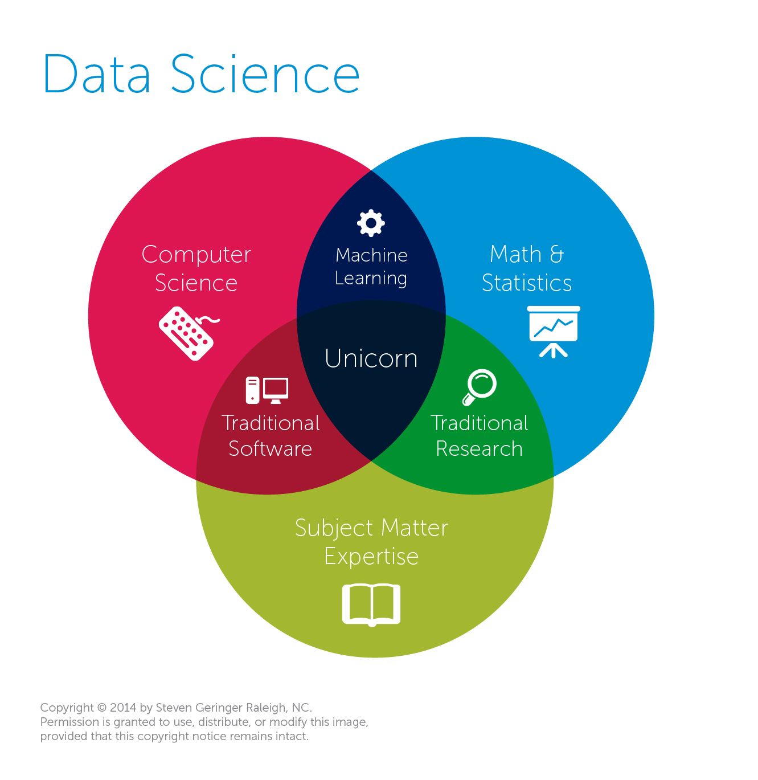
Data Mining & Science is almost always missing business acumen.
Traditional View
Data Science
The study of information with the goal of extracting meaningful insights and creating actionable recommendations.
*often does not require “big data” or extremely exotic approaches to have a business impact
Machine Learning
An outgrowth of artificial intelligence, machine learning is the set of tools, methodologies and techniques allowing a computer to “learn” about a specific situations represented with data.

Slide 13
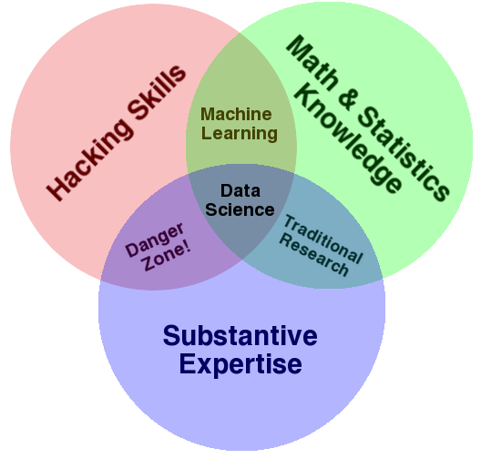
Expertise is not confined to math or CS…but learning business implications.
Another Popular View
Why hacking skills?
Data science takes creativity
Art & Science
A sprinkle of obsessive behavior to explain the data phenomenon
My $0.02
Both diagrams have expertise yet it is often overlooked. Many data scientists are technically sound but lack business acumen or substantive expertise.

Slide 14
Diagnosing & Defining a data mining project
Questions to Ask:
Is this a data mining problem? If so, what data would be helpful?
What is the current state?
What are the possible outcomes of the business scenario?
How will the outcome of the data mining project be used?
What is success for this project?

Slide 15

Pitfalls
Without asking these questions your efforts will:
Have scope-creep or never end!
Be difficult to define success
Be difficult to implement or have a limited impact

Slide 16

Let’s do this for real…
Meet Dale
Runs the analytics group at Busy-ness Corp a large conglomerate that makes, distributes and services corn dogs.
He looks miserable because senior leaders make his job harder than needed.
Let’s help Dale add some structure to his data mining projects.

Slide 17

Let’s do this for real
Hey Dale, its me…the boss.
I read in the WSJ that everyone should be using blockchain. Should we?
Is this a data mining problem?
What is the current state?
What are the possible outcomes of the business scenario?
How will the outcome of the data mining project be used?

Slide 18

Let’s do this for real
Your Daleness, I work in marketing and want to look intelligent (hence the glasses). I want to do a mailing to prospective corndog eaters. Can you identify how many postcards we should send & ROI?
Is this a data mining problem?
What is the current state?
What are the possible outcomes of the business scenario?
How will the outcome of the data mining project be used?

Slide 19

Let’s do this for real
Dale-areno! I think we are getting a lot more calls than usual about defective corn dogs. Can you look into whether or not that’s true?
Is this a data mining problem?
What is the current state?
What are the possible outcomes of the business scenario?
How will the outcome of the data mining project be used?

Slide 20

Let’s do this for real
The Notorious DALE, let’s forecast how many of our current corn dog debtors will be delinquent. Is that getting better or worse over time?
Is this a data mining problem?
What is the current state?
What are the possible outcomes of the business scenario?
How will the outcome of the data mining project be used?

Slide 21

Let’s do this for real
The East coast regional corn dog sales are up! I wonder if my region is worse than the West coast region.
Is this a data mining problem?
What is the current state?
What are the possible outcomes of the business scenario?
How will the outcome of the data mining project be used?

Slide 22

Let’s do this for real
Despite that idiot in marketing selling defective dogs, we need a new warehouse in the East region. Which zip code should we build it in to support a strong workforce?
Is this a data mining problem?
What is the current state?
What are the possible outcomes of the business scenario?
How will the outcome of the data mining project be used?

Slide 23


Let’s call Dale to tell him what we learned.
https://www.motionelements.com/stock-video-3902092-successful-black-businessman

Slide 24
Types of Problems
Retrospective
Descriptive
Data Science
Predictive
Supervised Learning
Classification
Binary
Multi-Class
Continuous
Forecasting
Unsupervised Learning
Associative System

Slide 25
Types of Problems
Retrospective
Descriptive
Data Science
Predictive
Supervised Learning
Classification
Binary
Multi-Class
Continuous
Forecasting
Unsupervised Learning
Associative System
How did we do last quarter?
Usually point in time and standalone information not summary.

Slide 26
Types of Problems
Retrospective
Descriptive
Data Science
Predictive
Supervised Learning
Classification
Binary
Multi-Class
Continuous
Forecasting
Unsupervised Learning
Associative System
What is the average number of donuts served each morning?
Retrospective but can be summary and/or in comparison to other data.

Slide 27
Types of Problems
Retrospective
Descriptive
Data Science
Predictive
Supervised Learning
Classification
Binary
Multi-Class
Continuous
Forecasting
Unsupervised Learning
Associative System
Ask yourself is there an outcome variable that we want to predict.
Will the next person that calls accept the credit card offer?
The outcome is 1 = yes, 0=no, they will accept.

Slide 28
Supervised Learning
Goal: Predict a single “target” or “outcome” variable
Training data, where target value is known
Score to data where value is not known
Methods: Classification and Prediction

Slide 29
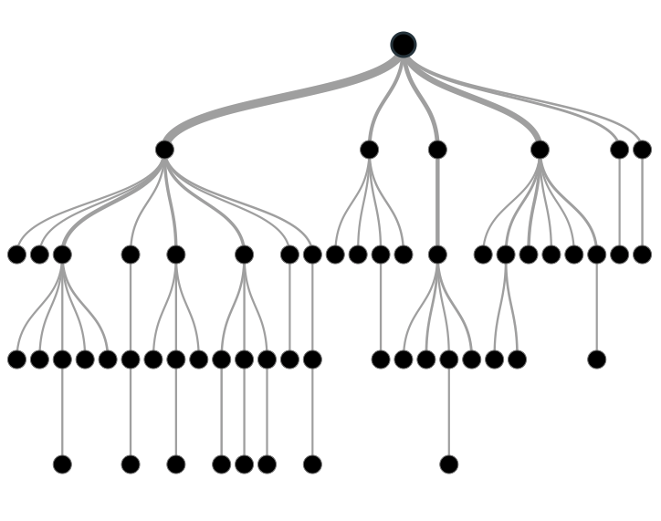

Supervised Learning
Inferring a function from labeled data.
“Learn from telling”, “Look at my data and I will tell you what to predict”
Data Setup
Method
Business Examples
Application
Marketing-Will a customer buy yes or no? How much will a customer spend?
Operations- Will an applicant default? When will a machine break?
Flat “Excel” file. Each row is a record or observation. Each column is an attribute of the record.
One column is the outcome, y or target attribute.
Modeling e.g. K-NN, linear regression, decision tree, random forest etc.
Use the model to make predictions for the target label on the new data.

Slide 30
Types of Problems
Retrospective
Descriptive
Data Science
Predictive
Supervised Learning
Classification
Binary
Multi-Class
Continuous
Forecasting
Unsupervised Learning
Associative System
Ask yourself is there an outcome variable that we want to predict.
Will the next person that calls accept the credit card offer?
The outcome is 1 = yes, 0=no, they will accept.

Slide 31
Supervised: Classification
Goal: Predict categorical target (outcome) variable
Examples: Purchase/no purchase, fraud/no fraud, creditworthy/not creditworthy…
Each row is a case (customer, tax return, applicant)
Each column is a variable
Target variable is often binary (yes/no)

Slide 32
Types of Problems
Retrospective
Descriptive
Data Science
Predictive
Supervised Learning
Classification
Binary
Multi-Class
Continuous
Forecasting
Unsupervised Learning
Associative System
Ask yourself is there an outcome variable that we want to predict.
Will the next patron order a wine, beer, or cocktail?
The outcome is one of three classes, wine, beer, or cocktail.

Slide 33
Types of Problems
Retrospective
Descriptive
Data Science
Predictive
Supervised Learning
Classification
Binary
Multi-Class
Continuous
Forecasting
Unsupervised Learning
Associative System
Ask yourself is there an outcome variable that we want to predict.
How many ice cream cones will we sell on an 85 degree, Saturday?
(the outcome is a continuous 0 to some number of cones)

Slide 34
Supervised: Prediction
Goal: Predict numerical target (outcome) variable
Examples: sales, revenue, performance
As in classification:
Each row is a case (customer, tax return, applicant)
Each column is a variable
Taken together, classification and prediction constitute “predictive analytics”

Slide 35
Types of Problems
Retrospective
Descriptive
Data Science
Predictive
Supervised Learning
Classification
Binary
Multi-Class
Continuous
Forecasting
Unsupervised Learning
Associative System
Ask yourself is there an outcome variable that we want to predict.
How much corn meal will we need for our corn dogs this month?
(there is an outcome, and the data is time related)

Slide 36
Types of Problems
Retrospective
Descriptive
Data Science
Predictive
Supervised Learning
Classification
Binary
Multi-Class
Continuous
Forecasting
Unsupervised Learning
Associative System
Ask yourself is there an outcome variable that we want to predict.
Can our customer data base be grouped in some meaningful way?
(there is no clear outcome to predict, we can observe and explore the clusters within the customer db)

Slide 37
Unsupervised Learning
Goal: Segment data into meaningful segments; detect patterns
There is no target (outcome) variable to predict or classify
Methods: Association rules, data reduction & exploration, visualization

Slide 38
Unsupervised Learning
Trying to find hidden structure in unlabelled data.
“Learn from observing”, “Look at my data and tell me about it”
Data Setup
Method
Business Examples
Application
Marketing-Find customer segments for specific marketing campaigns.
Operations-Identify locations for cell towers based on population density and area characteristics.
Text Analysis- Topic modeling of articles
Flat “Excel” file. Each row is a record or observation. Each column is an attribute of the record.
Clustering e.g. K-Means, Hierarchical Clustering etc
In new data find the customers/observations that most likely are part of a particular cluster.

Slide 39
Types of Problems
Retrospective
Descriptive
Data Science
Predictive
Supervised Learning
Classification
Binary
Multi-Class
Continuous
Forecasting
Unsupervised Learning
Associative System
Ask yourself is there an outcome variable that we want to predict.
What should we offer customers that bought the corn dog?
(There is not really a distinct outcome, only observed data similar to the unsupervised example. Should we offer additional dogs, condiments, orange soda, red wine, steak etc. Among all choices, how are items associated based on purchase history?)

Slide 40
Unsupervised: Association Rules
Goal: Produce rules that define “what goes with what”
Example: “If X was purchased, Y was also purchased”
Rows are transactions
Used in recommender systems – “Our records show you bought X, you may also like Y”
Also called “affinity analysis”

Slide 41

Your turn…
Methods
Scenarios
Retrospective
Descriptive
Data Science
Predictive
Supervised Learning
Classification
Binary
Multi-Class
Continuous
Forecasting
Unsupervised Learning
Associative System
Will the Celtics (basketball team) win the game?

Slide 42

Your turn…
Methods
Scenarios
Retrospective
Descriptive
Data Science
Predictive
Supervised Learning
Classification
Binary
Multi-Class
Continuous
Forecasting
Unsupervised Learning
Associative System
How did same stores sales change year over year?

Slide 43

Your turn…
Methods
Scenarios
Retrospective
Descriptive
Data Science
Predictive
Supervised Learning
Classification
Binary
Multi-Class
Continuous
Forecasting
Unsupervised Learning
Associative System
What should we place next to the cheese in the grocery cooler?

Slide 44

Your turn…
Methods
Scenarios
Retrospective
Descriptive
Data Science
Predictive
Supervised Learning
Classification
Binary
Multi-Class
Continuous
Forecasting
Unsupervised Learning
Associative System
How many patients should we expect in the urgent care tomorrow?

Slide 45

Your turn…
Methods
Scenarios
Retrospective
Descriptive
Data Science
Predictive
Supervised Learning
Classification
Binary
Multi-Class
Continuous
Forecasting
Unsupervised Learning
Associative System
How many wickets will the Chennai SuperKings make?

Slide 46
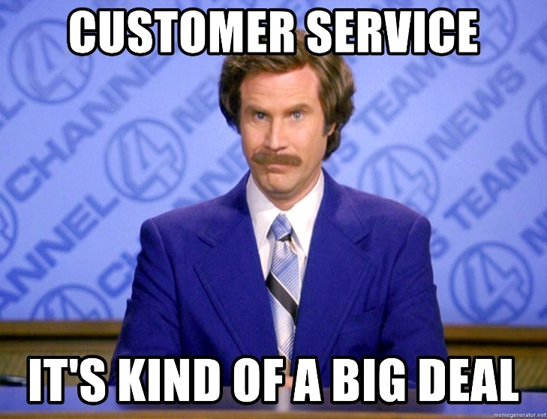
Your turn…
Methods
Scenarios
Retrospective
Descriptive
Data Science
Predictive
Supervised Learning
Classification
Binary
Multi-Class
Continuous
Forecasting
Unsupervised Learning
Associative System
What are our customer personas and how are they similar by account attribute?

Slide 47
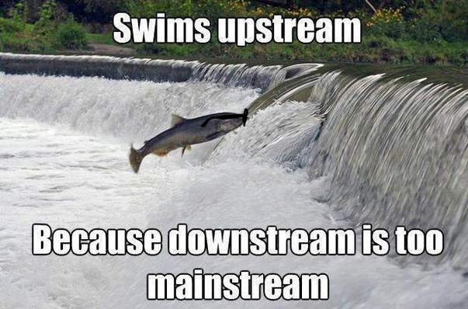
Your turn…
Methods
Scenarios
Retrospective
Descriptive
Data Science
Predictive
Supervised Learning
Classification
Binary
Multi-Class
Continuous
Forecasting
Unsupervised Learning
Associative System
How many fish did each vessel catch yesterday?

Slide 48
Your turn…
Methods
Scenarios
Retrospective
Descriptive
Data Science
Predictive
Supervised Learning
Classification
Binary
Multi-Class
Continuous
Forecasting
Unsupervised Learning
Associative System
Will the Celtics win the game?
How many wickets will the Chennai SuperKings make?
What should we place next to the cheese in the grocery cooler?
How did same stores sales change year over year?
How many patients should we expect in the urgent care tomorrow?
What are our customer personas and how are they similar by account attribute?
How many fish did each vessel catch yesterday?

Slide 49
Quiz!
Is there a target variable in unsupervised learning?
True or False? Data Science is defined as the study of information with the goal of extracting meaningful insights and creating actionable recommendations.
Data scientists need what type of skills?
What is an example of a supervised learning business question?
Name three data attributes would you need for that example.

Slide 50
Agenda
Start | End | Item
 |  | Introductions
 |  | Syllabus Review
 |  | Break
 |  | Core Concepts in Data Mining
 |  | Q/A, Individualized help w/R environment & git

Slide 51
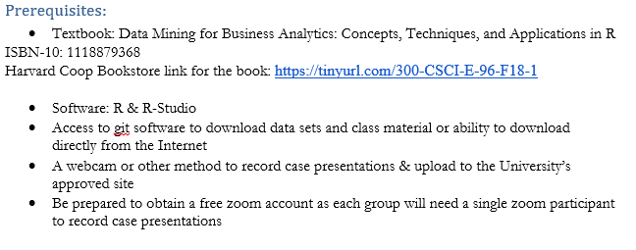
Install R Studio & Git
If you don’t have it installed yet, please do so now!! The rest of the course and your learning utilizes R Studio.

Slide 52
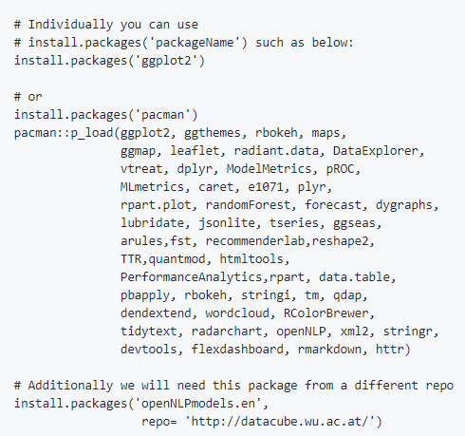
Libraries to install…we cover a lot in this course!
Please review the readme file of the Student repo!!

Slide 53

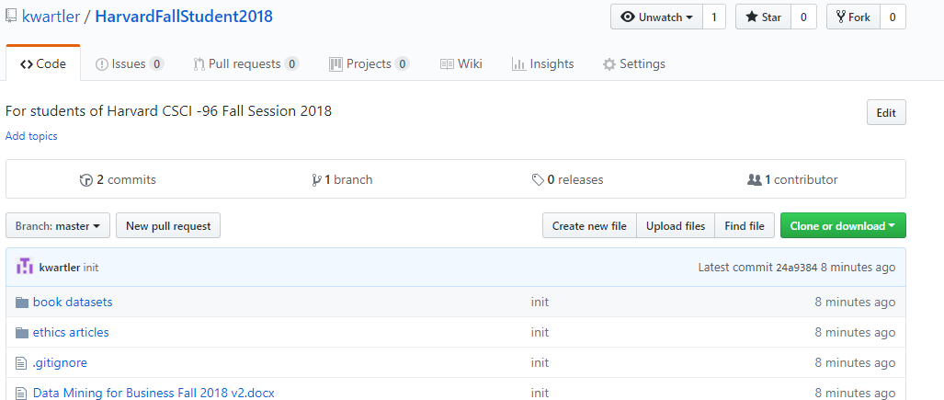
To get scripts, ppts & data use the class repo
github.com/kwartler/HarvardFallStudent2018
If you have git software, when do a “git pull” in Rstudio.
Alternatively you can download a zip of the repo on github.com but this can be cumbersome with file updates.

Slide 54
Housekeeping , Reading & Homework
Make sure you have R Studio Installed
Recommended to install Git locally for “git pull”
Connect your local to the class repo
Organize into groups of 4-5 for the two cases studies. This can be done on piazza.
Chapter 1 & Chapter 2
0. Piazza introduction post
1 . Day1_Homework_v2.R
2. C2.1 Data Mining Techniques
3. C2.2 Data Partition
4. C2.3 Data Sample
5. C2.4 Modeling Steps

